Slide 1


PLEDGE TO PROGRESS Sustainability Hackathon
Sponsored By
Your Team Name: Helix
Your Team Bio:
Divyanshi, Harshada, Preeti & Snehal, we are passionate engineers who like to explore new technologies, develop quick and useful solutions for improving processes. Participating in hackathons give us opportunities to go beyond our office work and explore new ideas
Idea Name: Green DevOps
Date: 24-Apr-2023

Slide 2
Problem Statement
DevOps Process can cause significant emissions which users are unaware of. The solution will monitor, estimate emissions and suggest actions to improve inefficiencies in process and reduce emissions.
With the new era of fast paced development introduced with DevOps concepts we are trying to go to market with new feature as soon as possible.
To ensure this the tools provide unlimited resources to DevOps engineers. As these resources are running as black box, DevOps engineers are unaware of emissions and scope for reduction.
During our research with the currently available tools there are multiple tools around development and design patterns, runtime software optimizations for reducing emissions. AI/ML workloads but limited focus on the DevOps practices.
The idea is to ensure all personas (DevOps engineers, Release Engineers, Management, Business) involved in this process are aware of total emissions, inefficiencies in processes if any. Later on provide advice to these personas of how to transform the process green.
A Step Towards Greener Choices

Slide 3
User Segment & Pain Points
DevOps Engineers
- Unaware of emissions
- Best practices for sustainable DevOps system
Management Team
- Understand and report the emissions, actions taken, it is currently hard to capture consolidated information from the SDLC processes
- Management team has sustainability targets to fulfill, understanding targets and progress is difficult due to unavailability of monitoring system

Slide 4
Pre-Requisite
There are multiple initiative to define best practices from sustainable DevOps process.
The features which are missing are for quantification of the emissions and impact of implementing best practices.
There are few tools available for automating process using ChatGPT/AI etc. but these processes inherently cause more emissions so our approach is keep it simple and improve.

Slide 5
Tools or resources
Azure tools or resources which are likely to be used by you for the prototype, if your idea gets selected
Azure DevOps for planning, collaborating, version control, Azure Boards for project management, Azure Pipelines for continuous integration and deployment of software projects.
Azure Sustainability Manager to monitor, reporting, and management of sustainability data
Azure cloud
It would be good to get an Azure subscription for the following needs -
Azure Storage services like Blob Storage, Table Storage, or Azure SQL Database to store data generated by your extension, such as carbon emissions estimates, energy consumption data, or user preferences.
Azure Monitor to monitor the performance and usage of the extension

Slide 6
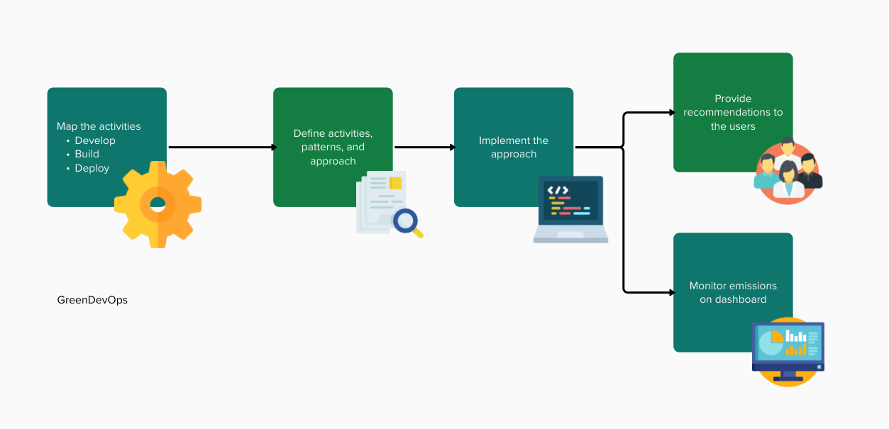
Proposed Solution
Mapping of the practices following with develop, build, deploy
Define activities and approach to measure the emissions
Identify patterns for efficient DevOps processes
Implement these patterns to provide suggestions to the users
Monitor the emissions on dashboards to measure and take appropriate action on the same

Slide 7
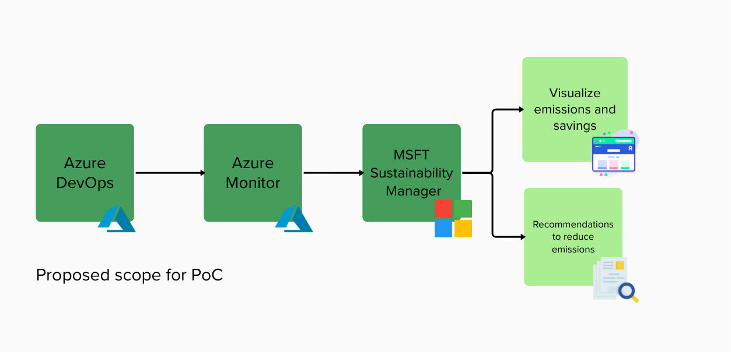
Proposed Scope of POC
Develop an application to fetch details from ADO – like code change in pr, code changes from last merge, retention policies, active branches, test executed, scans executed, idle agents
Define activities in MSFT sustainability manager
Ingest the collected data from ADO monitoring app to MSFT sustainability platform
Visualize emissions, savings
Provide recommendations to reduce emissions

Slide 8
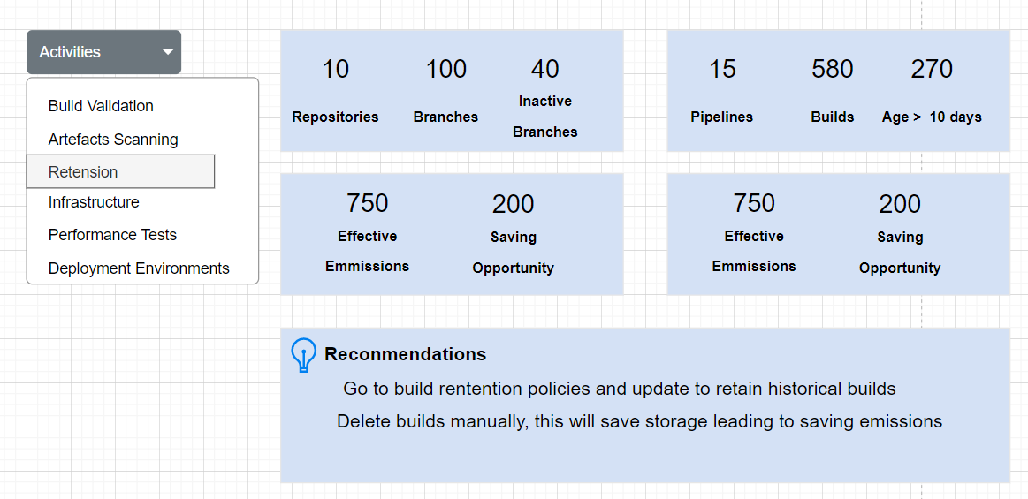
Sample Wireframes

Slide 9
Key Differentiators & Adoption Plan
Key Differentiators
Contribution to green software development patterns for DevOps
Extensibility to develop monitoring for platforms other than Azure DevOps (ADO)
Usage of sustainability manager platform, to define generic activity to map emissions
Adoption Plan
Plan to release Alpha version to 10 selected users to get feedback (7 DevOps engineers, 3 management representatives) - This version will be deployed on the resources used from Hackathon
Feedback will be based on Usability of interface and usefulness of insights generated - Incorporate feedback
For adoption of final version - Publish the version on open source GIT repo with detailed steps for integration and keep it open for community contribution

Slide 10
Thank You
Divyanshi Mangal
Harshada Modak
Preeti Solanki
Snehal Jagtap

